Slide 1
Image Feature Correspondences for Camera Calibration
Software Requirements Specification
Kiran Singh
CAS 741
2025-01-24

Slide 2
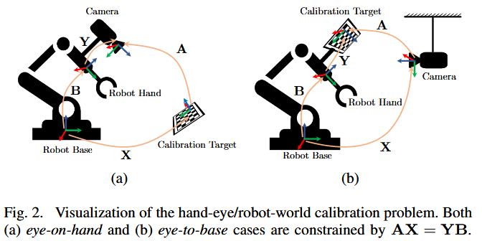
Overview
Cameras need to be calibrated to provide useful data
Current methods face trade-offs. Inclusive of:
local solver tools
pre-known calibration targets/features of known scale within the environment
Overlap in camera fields-of-view (FOV)
Thesis goal is to ‘robustify’ calibration in comparison to SOTA methods
Envisioned to be completed in two steps:
Identify features from ‘key points’ in imagery data for use as calibration targets
Compute robotic posed transforms in HERW formulation via a global optimization algorithm
Y. Wang, W. Jiang, K. Huang, S. Schwertfeger, and L. Kneip, “Accurate Calibration of Multi-Perspective Cameras from a Generalization of the Hand-Eye Constraint,” in 2022 International Conference on Robotics and Automation (ICRA), Philadelphia, PA, USA: IEEE, May 2022, pp. 1244–1250. doi: 10.1109/ICRA46639.2022.9811577.
Scope for CAS 741

Slide 3
Perceived Workflow – Separate to SRS
Image Feature Correspondence Software
Camera Parameters / Imagery Stream
Feature Identification
Feature Comparison
Graph Network Generation
Graph Network
Flagged Transforms
Feature Detection Algorithm
w/ Threshold Criteria
Feature Comparison Algorithm
w/ Threshold Criteria

Slide 4
Goals Statements
Provided the configuration data of each camera, inclusive of the intrinsic parameters and imagery streams, and the ground-truth robot pose, the goals of this software are:
Goal ID | Description
GS01 | Define a collection of features from each image frame.
GS02 | Define the criteria used to compare identified features between separate image frames.
GS03 | Compare the identified features from GS01 between each image frame.
GS04 | Compute the number of matches in each image frame per the criteria in GS02.
GS05 | Generate a report of the matched features between each image.

Slide 5
Assumptions
Goal ID | Description
A01 | The ambient illumination conditions remain constant between successive images. [TM02]
A02 | Overlap between the FOV of any cameras is not guaranteed. [LC01]
A03 | Features may be extracted from each camera frame. [LC01]
A04 | All supplied imagery is produced by a pinhole model, affine camera. [TM01]
A05 | Intrinsic calibration parameters are static for each camera. [TM01]
A06 | The transform between the robot coordinate measurement and the robot base frame is assumed to be used as an input. [LC01]
A07 | Camera lens distortion can be ignored [TM01].

Slide 6
Inputs and Outputs
Inputs
In1) Camera configuration parameters
In1A) Quantity of cameras, i (i >0)
In1B) Camera Intrinsic Parameters (TM01)
In2) Robot Pose Ground Truth (P_{i})
Global Position of end-effector
Translation (Cartesian Coordinates)
Rotation (Roll, Pitch, Yaw – const. from –π < θ ≤ π)
In3) Imagery stream data
For pose P_{i} and camera C_{j}
Imagery resolution, m _{x} n, (m, n > 0)
Imagery vector ** (Greyscale vs RBG)
In4A) Feature Detector Algorithm*
In4B) User-defined threshold
In5A) Feature Comparison Algorithm**
In5B) User-defined threshold
Outputs
For each camera, C
Out1) For each image, i:
A graph of identified features and its constitutive points
Out2) A graph of each matched feature with the corresponding camera, image frame, and matched features
Out3) A confidence metric for each matched feature
Out4) A list of transforms to be calculated between each matched feature
Notes:
How do we encapsulate the Feature Detector and Feature Comparison Algorithms

Slide 7
Theoretical Models
Need to redefine how the theoretical models are defined such that we do not over specify:
What type of feature detection/matching algorithm are employed
What the selection criteria are of a correspondence, for similar reasons to (1)
ID | Description
TM01 | Intrinsic Camera Parameter, K
TM02 | Integral Image
TM03 | Hessian-Based Interest Points [LC01]

Slide 8
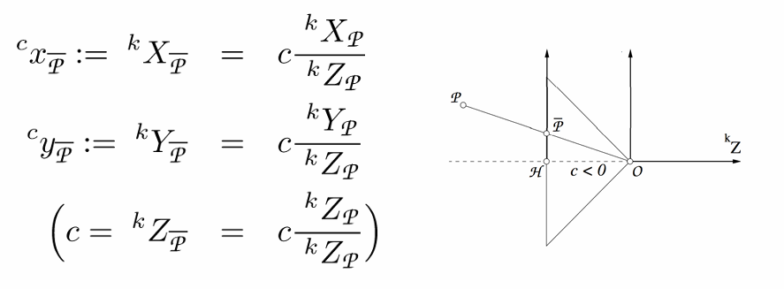
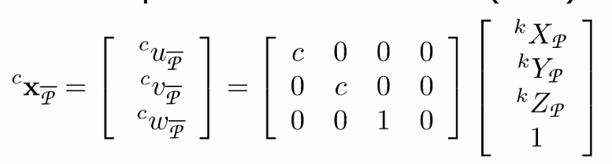

Theoretical Models – TM01
For a known point, P, we obtain its coordinates for the projection point on the 2D image plane
Assumptions
Pinhole camera model – A04
Lens distortion is ignored camera model – A07
Initial Calibration Parameters (K) are static – A05
C. Stachniss. (2021). Camera Parameters: Extrinsics and Intrinsics [Online]. Available: https://www.ipb.uni-bonn.de/html/teaching/photo12-2021/2021-pho1-20-camera-params.pptx.pdf.

Slide 9
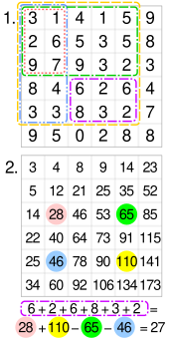

Theoretical Models – TM02
For point X in each image, a ‘summed image’ contains the summation of the image intensity for all pixels formed by the origin and point X.
D. Tyagi, “Introduction to SURF (Speeded-Up Robust Features),” Medium, Apr. 07, 2020. https://medium.com/@deepanshut041/introduction-to-surf-speeded-up-robust-features-c7396d6e7c4e
‌‌
Wikipedia Contributors, “Summed-area table,” Wikipedia, Sep. 21, 2019. https://en.wikipedia.org/wiki/Summed-area_table
‌

Slide 10
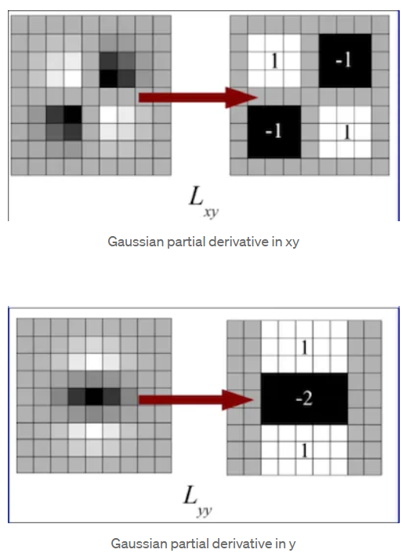
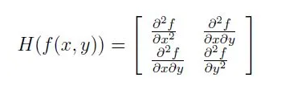
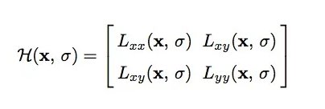
Theoretical Models – TM03 [LC02]
Some variants for feature detection used Hessian-based interest points
For a given pixel X = (x,y)
Adapt to a defined scale, σ, with a Gaussian Kernel *
D. Tyagi, “Introduction to SURF (Speeded-Up Robust Features),” Medium, Apr. 07, 2020. https://medium.com/@deepanshut041/introduction-to-surf-speeded-up-robust-features-c7396d6e7c4e
‌‌

Slide 11
General Definitions
Feature – a flag that classifies a collection of key points in image I to be contain similar properties as outlined in the Feature Detection Algorithm (mathematical definition needs to be defined*)
Correspondence – a flag between two identified features from separate images which exceeds the comparison threshold as defined in the Feature Comparison Algorithm (mathematical definition needs to be defined*)

Slide 12
Draft Instanced Models
In Progress
Dependent on the conclusions for the TM, GD, DD

Slide 13
Likely Changes
LC01 – A02, A03, and A06 may be deleted as they are currently not linked to any other definition/model.
LC02 - TM03 may be deleted as it over specifies the methodology of what algorithm should be used

Slide 14
Functional / Non-Functional Requirements
Future Work
To be discussed following revisions to TM, GD, DD, and IMs

